Slide 1





P2E: POWER TO EMPOWER CHALLENGE
IEEE SIGHT Group Tunisia Section & IEEE TEMS/SSIT Tunisia Section Joint Chapter
TSYP 13 TECHNICAL CHALLENGE
Project Title:
RemindMeBox

Slide 2


CRISIS-AFFECTED AREAS
70%
70%
of individuals struggle to maintain consistent medication routines due to disrupted access, and scarce caregiver support
1
_RemindMeBox_

Slide 3
COMPLEX REGIMENS IN HIGH-STRESS CONDITIONS
AMONG REFUGEES WITH CHRONIC DISEASES
ONLY
59.5%
59.5%
67%
59.5%
67%
67%
hypertension medication adherance
diabetes regimens adherance
2
_RemindMeBox_

Slide 4


COLLAPSE OF REAL-TIME MONITORING
LACK OF TRACKING ADHERANCE IN EMERGENCY SHELTERS, OVERLOADED COMMUNITY CENTERS, AND FRACTURED HEALTHCARE SYSTEMS
3
_RemindMeBox_

Slide 5
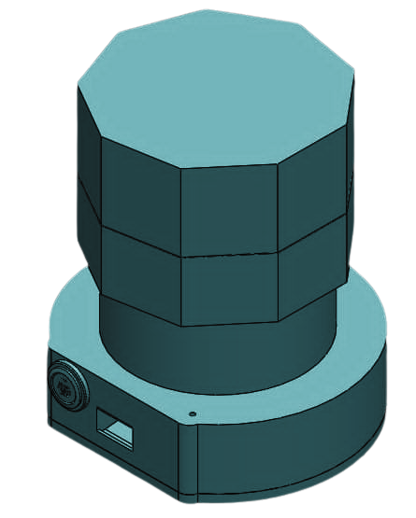
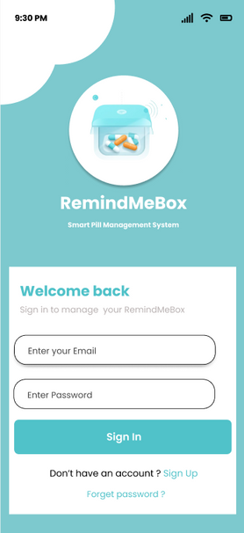
OUR SOLUTION
REMINDMEBOX
INTELLIGENT MEDICATION CONTROL FOR THE POLYCRISIS ERA
4
_RemindMeBox_

Slide 6





CORE FEATURES
ALERTS REMINDERS AND NOTFICATIONS
SMART AUTOMATED PILL DISPENSING SYSTEM
REAL TIME MONITORING VIA MOBILE APP
REAL TIME
TRACKING
AI ASSISTANCE
5
_RemindMeBox_

Slide 7

MISSION, VISION & VALUES
MISSION
VALUES
EMPOWERING THE VULNERABLE. SUPPORTING THE CAREGIVER
EFFICACY & RELIABILITY
ETHICAL & INCLUSIVE DESIGN
SUSTAINABLE RESILIENCE
HUMAN-CENTERED SUPPORT
VISION
REVOLUTIONIZING GLOBAL MEDICATION MANAGEMENT ESPECIALLY IN UNSTABLE ENVIRONMENTS.
_RemindMeBox_
6

Slide 8

SYSTEM OVERVIEW
REMINDMEBOX
CLOUD
MOBILE APP
7
_RemindMeBox_

Slide 9
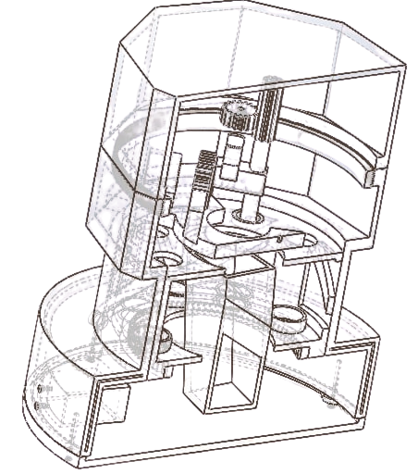
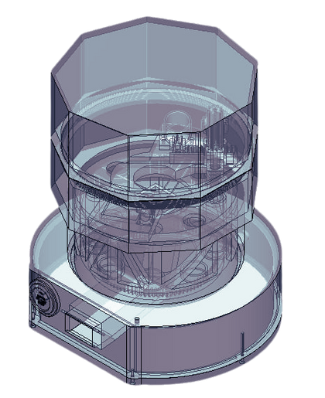
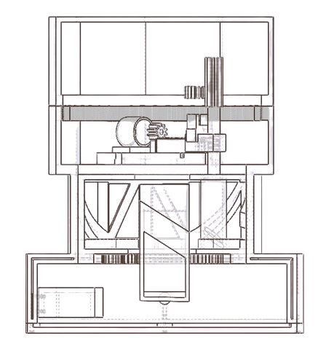
HARDWARE ARCHITECTURE
HARDWARE
MECHANICAL DESIGN
8
_RemindMeBox_

Slide 10
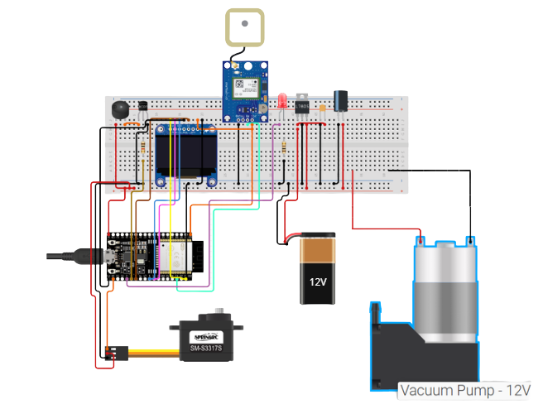
HARDWARE ARCHITECTURE
HARDWARE
ELECTRICAL DESIGN
GPS Module
Audio/Buzzer Module
LED Indicator
OLED
12 v Battery Pack
Servo motor
vaccum pump
9
_RemindMeBox_

Slide 11
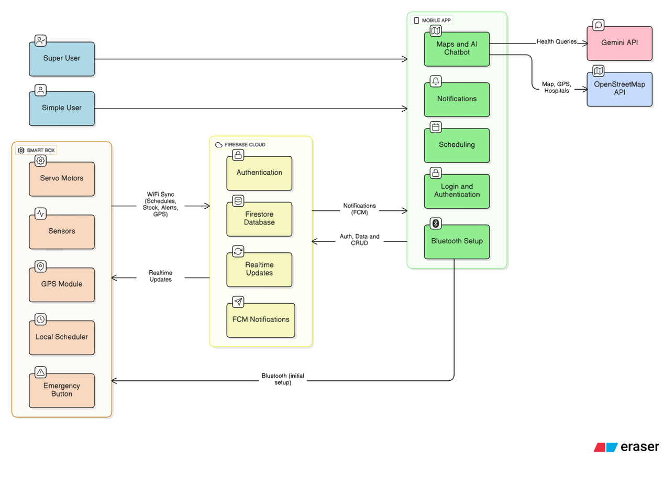
SOFTWARE ARCHITECTURE
SOFTWARE
SYSTEM WORKFLOW
10
_RemindMeBox_

Slide 12




SOFTWARE ARCHITECTURE
SOFTWARE
TOOLS & TECHNOLOGIES
FLUTTER
ARDUINO IDE
FIREBASE
GIT HUB
11
_RemindMeBox_

Slide 13




MARKET ANALYSIS
MARKET NEEDS
12
_RemindMeBox_

Slide 14
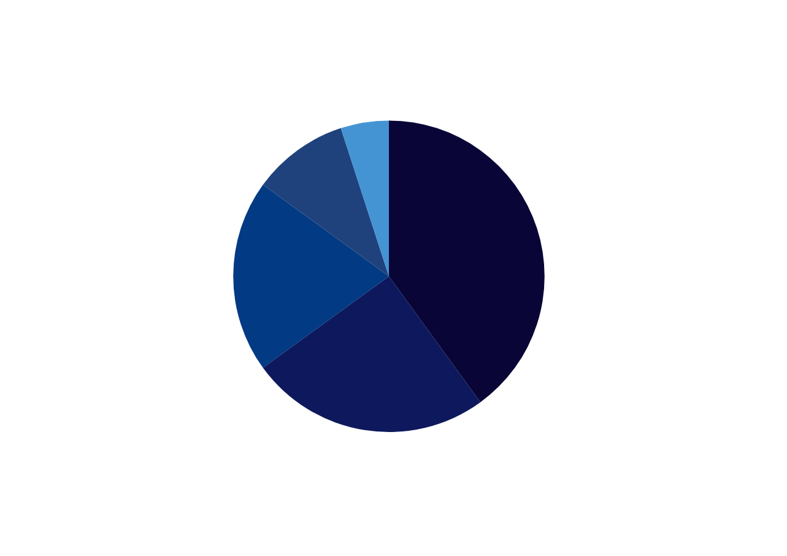
MARKET ANALYSIS
TARGET AUDIANCE
13
_RemindMeBox_

Slide 15





MARKET ANALYSIS
COMPETITIVE LANDSCAPE
DIRECT
INDIRECT
14
_RemindMeBox_

Slide 16
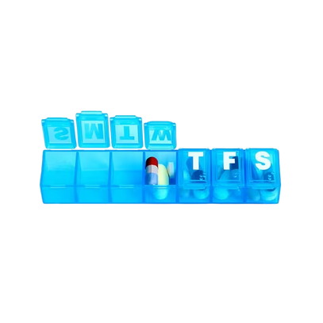

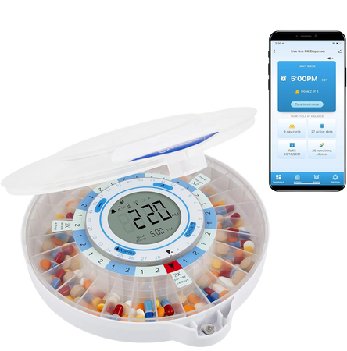


WHY REMIND ME BOX ?
DIFFERENCES HIGHLIGHTS
MANUAL PILL BOXES
REMINDER APPS
SMART DISPENSERS
REMIND ME BOX
Automated dispensing
Automated dispensing
Automated dispensing
Automated dispensing
Real-time monitoring
Real-time monitoring
Real-time monitoring
Real-time monitoring
AI assistance
AI assistance
AI assistance
AI assistance
Crisis Resilience
Crisis Resilience
Crisis Resilience
Crisis Resilience
Affordable & local
Affordable & local
Affordable & local
Affordable & local
15
_RemindMeBox_

Slide 17
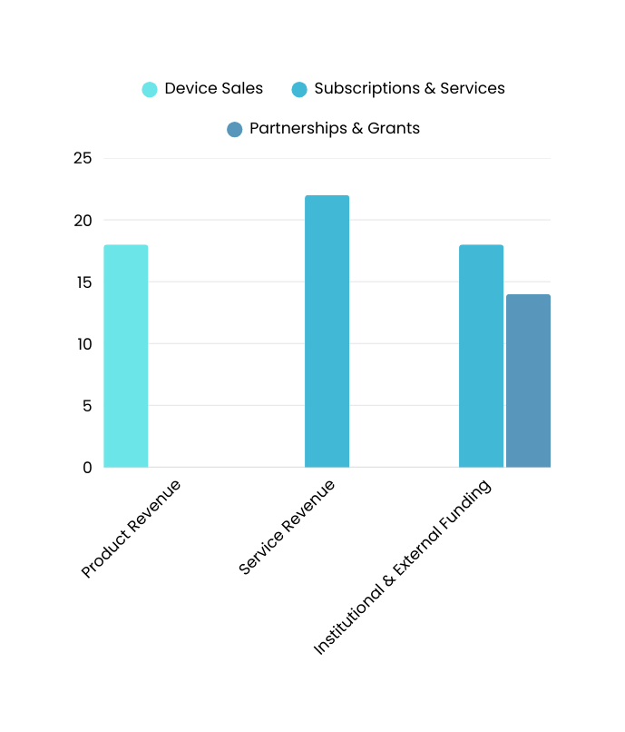
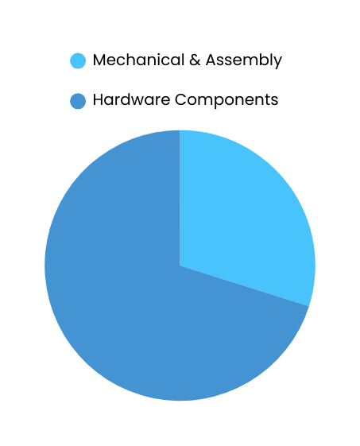
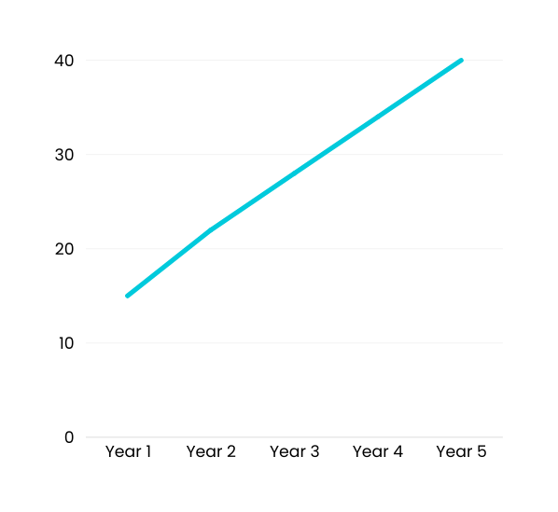
FINANCIAL ANALYSIS
REVENUE MODEL
PROTOTYPE COSTS
POTENTIAL ROI
Total Prototype cost :385 Dt
hardware components (270)
mechanical assembly (115)
16
_RemindMeBox_

Slide 18
BUSINESS MODEL CANVAS
  ELDERLY & CHRONIC PATIENTS
  FAMILY CAREGIVERS
  CLINICS & HOSPITALS
  HEALTH-FOCUSED NGOS
  EMERGING MARKETS
  IMPROVED MEDICATION ADHERENCE & SAFETY
  AUTOMATED AND SECURE PILL DISPENSING
  REAL-TIME CAREGIVER MONITORING
  SIMPLE REFILL & EASY MAINTENANCE
  AFFORDABLE AND ETHICAL SOLUTION
  HEALTHCARE PROVIDERS AND PHARMACIES
  GOVERNMENT HEALTH AGENCIES
  LOCAL AND INTERNATIONAL ACCELERATORS
  HARDWARE SUPPLIERS
  ACADEMIC INSTITUTIONS
  NGOS
  PRODUCT RESEARCH AND DEVELOPMENT
  DEVICE ASSEMBLY AND INTEGRATION
  CLOUD AND MOBILE SOFTWARE DEVELOPMENT
  TESTING AND CERTIFICATION
  COMPLIANCE MANAGEMENT
  DISTRIBUTION MANAGEMENT
  PERSONALIZED ONBOARDING & SUPPORT
  MOBILE APP & WEB ACCESS
  CAREGIVER AND HEALTHCARE PROFESSIONAL ACCESS
  COMMUNITY AWARENESS & ENGAGEMENT
KEY PARTNERS
KEY ACTIVITIES
VALUE PROPOSITIONS
CUSTOMER RELATIONSHIP
CUSTOMER SEGMENTS
  SMART HARDWARE & IOT INFRASTRUCTURE
  CLOUD & AI PLATFORM
  MULTIDISCIPLINARY TEAM (ENGINEERING, DATA, HEALTHCARE)
  MANUFACTURING & LOGISTICS CAPABILITIES
  STRATEGIC PARTNERSHIPS
  PARTNER PHARMACIES & CLINICS
  ONLINE PLATFORM (WEBSITE & APP)
  NGOS & SOCIAL PROGRAMS
  HEALTH EVENTS & DIGITAL CAMPAIGNS
KEY RESOURCES
CHANNELS
  HARDWARE PRODUCTION
  SOFTWARE & CLOUD MAINTENANCE
  CUSTOMER SUPPORT & TRAINING
  MARKETING & DISTRIBUTION
  CERTIFICATION & COMPLIANCE
  R&D
  DEVICE SALES
  SUBSCRIPTION FEES (MONITORING & APP)
  B2B & B2G PARTNERSHIPS
  SERVICE PACKAGES
  GRANTS & PILOT FUNDING
COST STRUCTURE
REVENUE STREAMS:
17
_RemindMeBox_

Slide 19


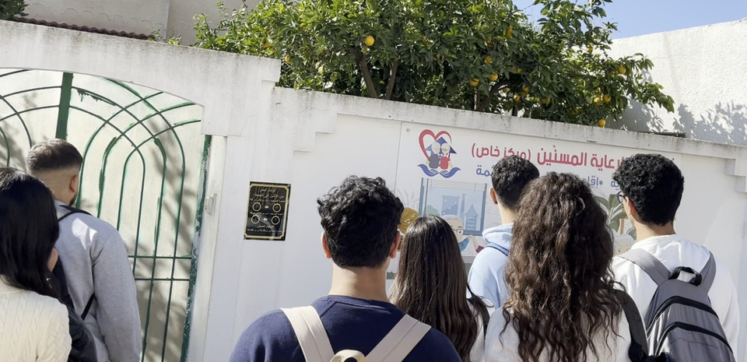
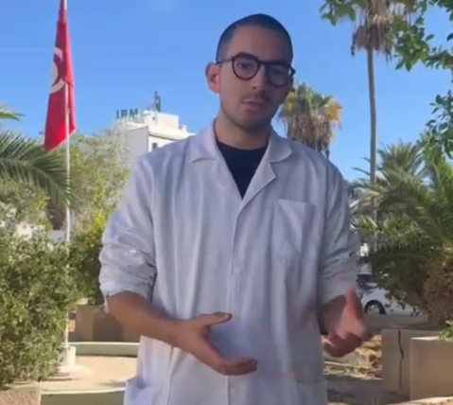
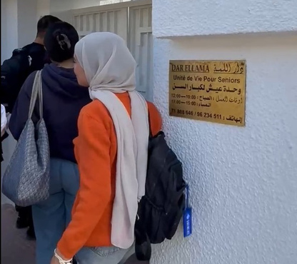


COLLABORATION WITH INDUSTRY PARTNERS AND NGO’S
18
_RemindMeBox_

Slide 20




IMPACT & SDG ALIGNMENT
SOCIAL IMPACT
ECONOMIC IMPACT
  Healthcare Continuity During Systemic Collapse
  Protection of Vulnerable Populations in Instability
  Community Resilience Building
  Cost Containment During Economic Shock
  Crisis-Responsive Job Creation
  Economic Productivity Preservation
19
_RemindMeBox_

Slide 21

ETHICS & UTOPIAN VALUES
EthiCAL CONSIDERATIONS
SOCIAL & UTOPIAN IMPACT
  Respect for Elderly Autonomy and Dignity in Systemic Collapse
  Privacy-by-Design and Secure Data Handling in Fragile Systems
  Transparent and Responsible Use of AI in Unstable Environments
  No Intrusive Surveillance or Exploitation in Vulnerable States
  Fair access to medication management through affordability
  Improved Quality of Life for Elderly in Societal Breakdown
  Reduced caregiver burden and healthcare inequalities
  Contribution to a More Inclusive and Sustainable Healthcare System in Collapse & Recovery
20
_RemindMeBox_

Slide 22



CONCLUSION & FUTURE PERSPECTIVE
  Integration with medical professionals
  Biometric verification
  Battery optimization & portability
  Regulatory compliance & certification
21
_RemindMeBox_

Slide 23
THANK YOU
_RemindMeBox_

